Slide 1
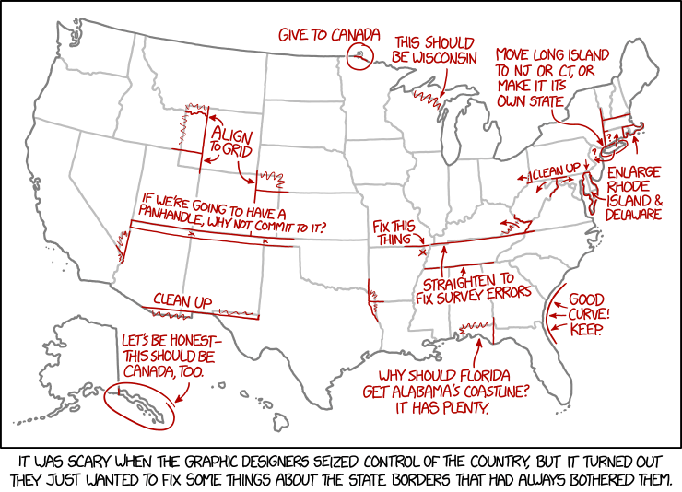
User interface design
xkcd

Slide 2
UI Design: Monday Sept 26
Dr. Jillian Aurisano
Plan for today:
Announcements/Course logistics
Graphic Design - simplicity
Notes:
So welcome to engineering visual interfaces for data science. I'm Dr Aurisano.
Thanks for finding the class on Zoom. Hopefully we will be in person again soon.
If anyone out there is comfortable turning on their cameras, that is lovely- then I feel like I am talking to students, rather than to myself.
Here’s our plan for today:
First I’m going to introduce myself, so you know a bit about me
Then we are going to get to know each other, in Zoom breakout rooms. This will give us a chance to make sure that Zoom breakout rooms work, and we all know how to access them.
Then, I am going to walk through the structure, and plan for the course. I want to make sure everyone knows how the course will work, and what to expect, and also a bit about why the course is designed this way.
Then I am going to introduce the class, and what the class is about. Since this is a new class, and one of just a few classes in human centered computing here at UC, I wanted to give an overview of the topic.
Then I have an introductory activity, which we will do in breakout rooms, and which I think will help motivate the discussion on Wednesday, and getting into the meat of the class.

Slide 3
Today: Graphic design
Simplicity
Layout
Grouping and Hierarchy
Balance and Symmetry
Alignment and Grids
Color

Slide 4
Simplicity
What is simplicity in a design?
Why is it good?

Slide 5
Simplicity
What is simplicity in a design?
Why is it good?
Nothing more to add
Nothing left to take away

Slide 6
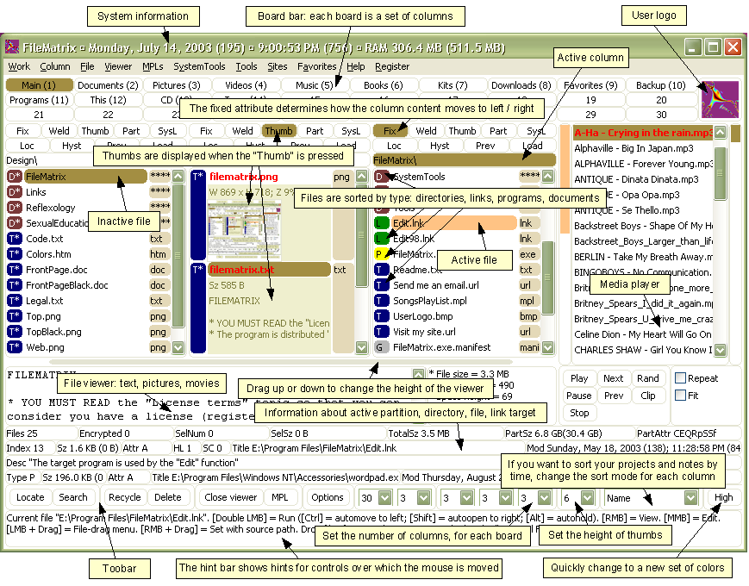
Simplicity- counter-example
File Matrix program
Complexity interferes with usability
Less learnable (hard to learn to use)
Less efficient (hard to find features quickly)
Less safe (easy to click the wrong place)

Slide 7

Simplicity
Compare to this Google home device

Slide 8
Simplicity is hard
Simplicity is in tension with our impulse to add more features and elements ‘just in case’
Simplicity forces you to have a good reason for everything you add, and to take away anything that can’t survive hard scrutiny

Slide 9
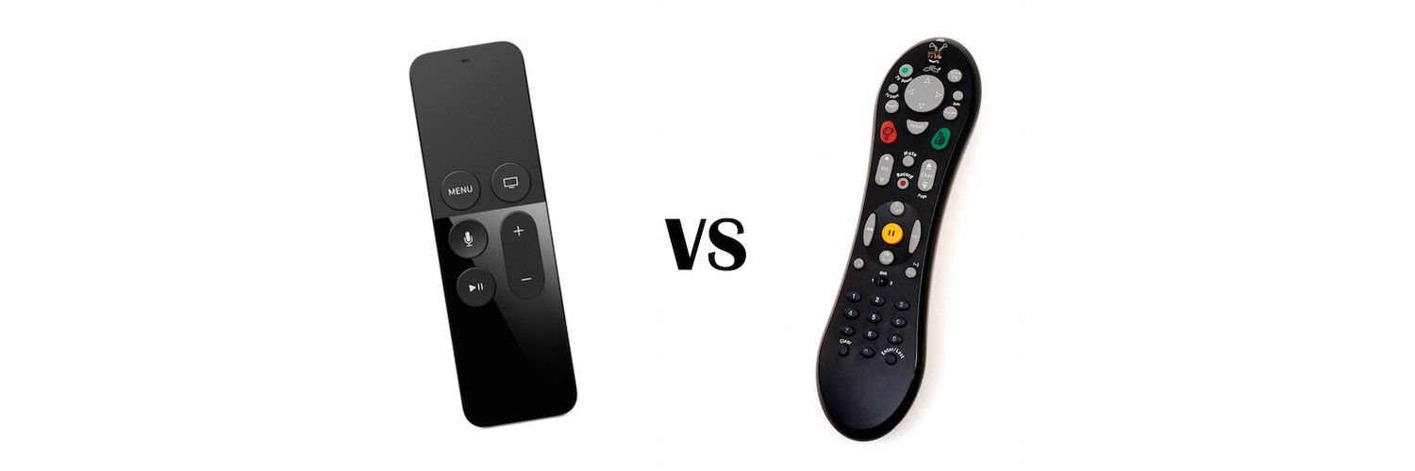
How to achieve simplicity: One approach: Reduction
Reduction:
Remove inessential elements
Remove inessential features
Even if it seems essential, try removing it anyway, to see if the design falls apart.

Slide 10
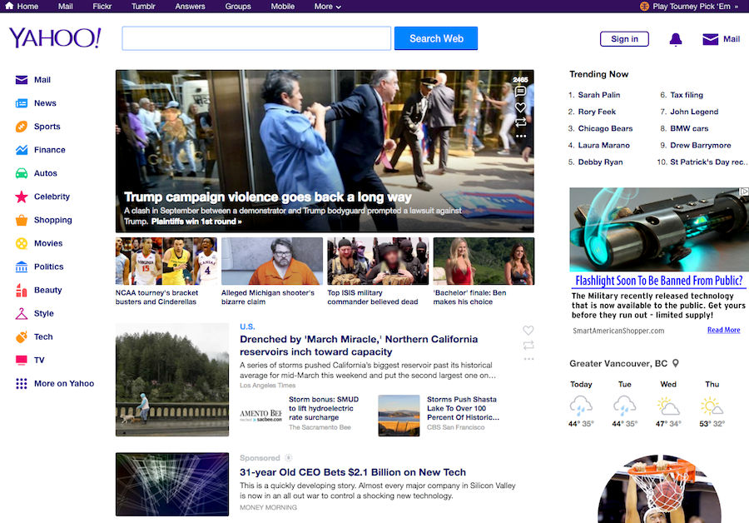
Reduction- understand your user’s main goal
Yahoo vs Google
Yahoo- what is included on main page?

Slide 11
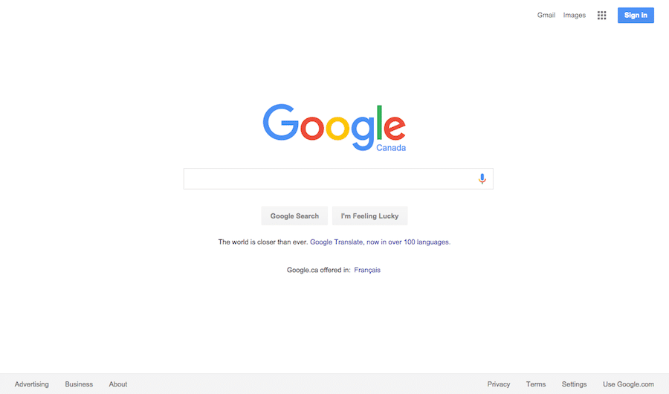
Reduction- understand your user’s main goal
Yahoo vs Google
What is on Google’s main page?

Slide 12
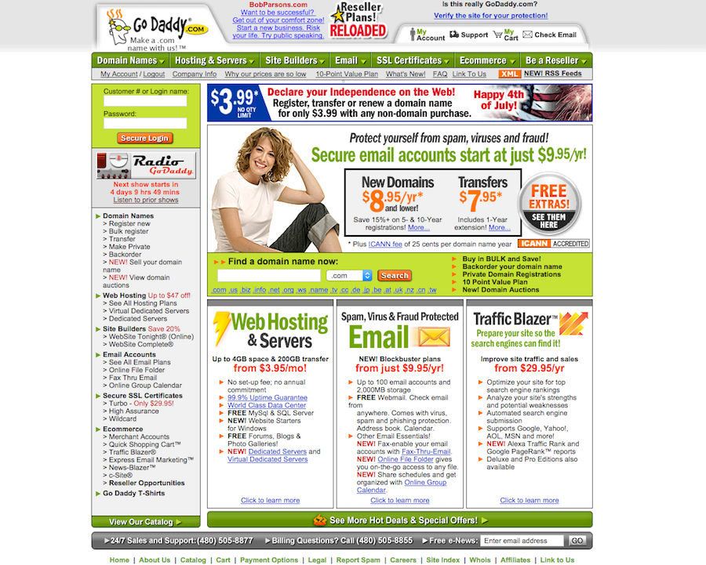
Reduction- another example
GoDaddy 2005 vs 2016

Slide 13
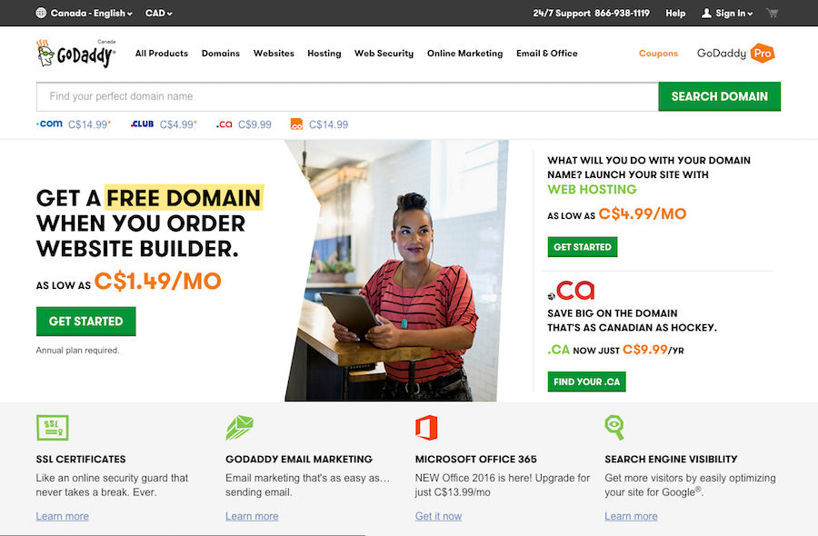
Reduction- another example
GoDaddy 2005 vs 2016

Slide 14
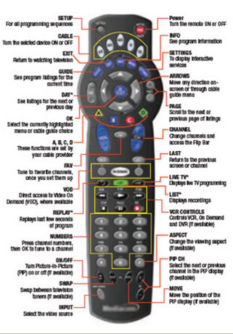
Return to the remote- how did it get this way?
Remotes evolved from the previous version
Always adding new buttons
Never taking away
Designed to operate without a visual interface on the screen
Everything needed a button
Designed for engineering simplicity, not usability
Easy to connect these buttons to operations in the TV

Slide 15
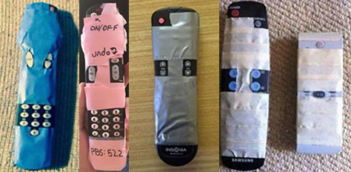
Remote- fixed!
Reddit

Slide 16
How to achieve simplicity: Regularity
Regularity: minimize the unnecessary differences
Use the same font, color, line width, dimensions, orientation for multiple elements
Irregularities in your design will be magnified in the user’s eyes and assigned meaning and significance.
Use a regular pattern
Limit inessential variation among elements

Slide 17
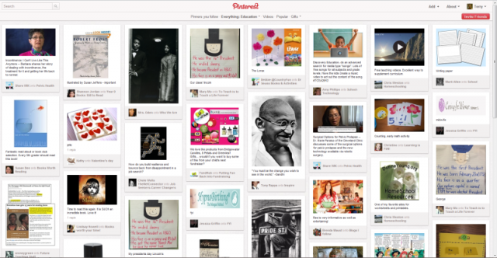
Regularity example: Pinterest regular column widths

Slide 18
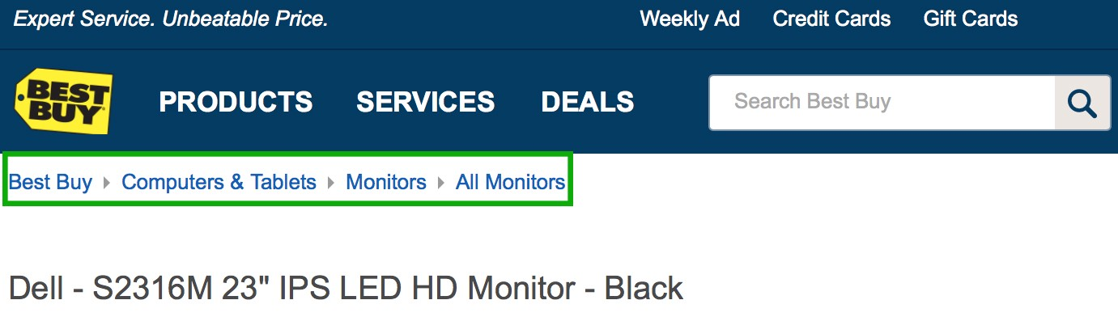
How to achieve simplicity: Double Duty
Try to combine elements to make them serve multiple roles in the design.
Example: a window’s title bar plays several roles
label, dragging handle, window activation indicator, and location for window control buttons.
The breadcrumbs pattern and the pagination pattern also do double duty

Slide 19
But can simplicity go too far?
Can anyone think of something they have used that is trying to be so simple, it is probably too simple?

Slide 20
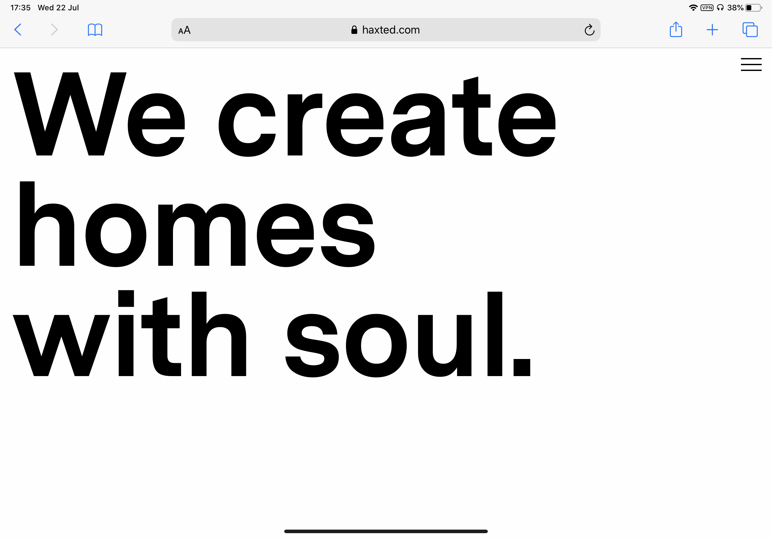
Example- overuse of hamburger menu
Why a hamburger menu (three lines, upper right) here on this desktop site?
Well maybe there are lots of links?

Slide 21
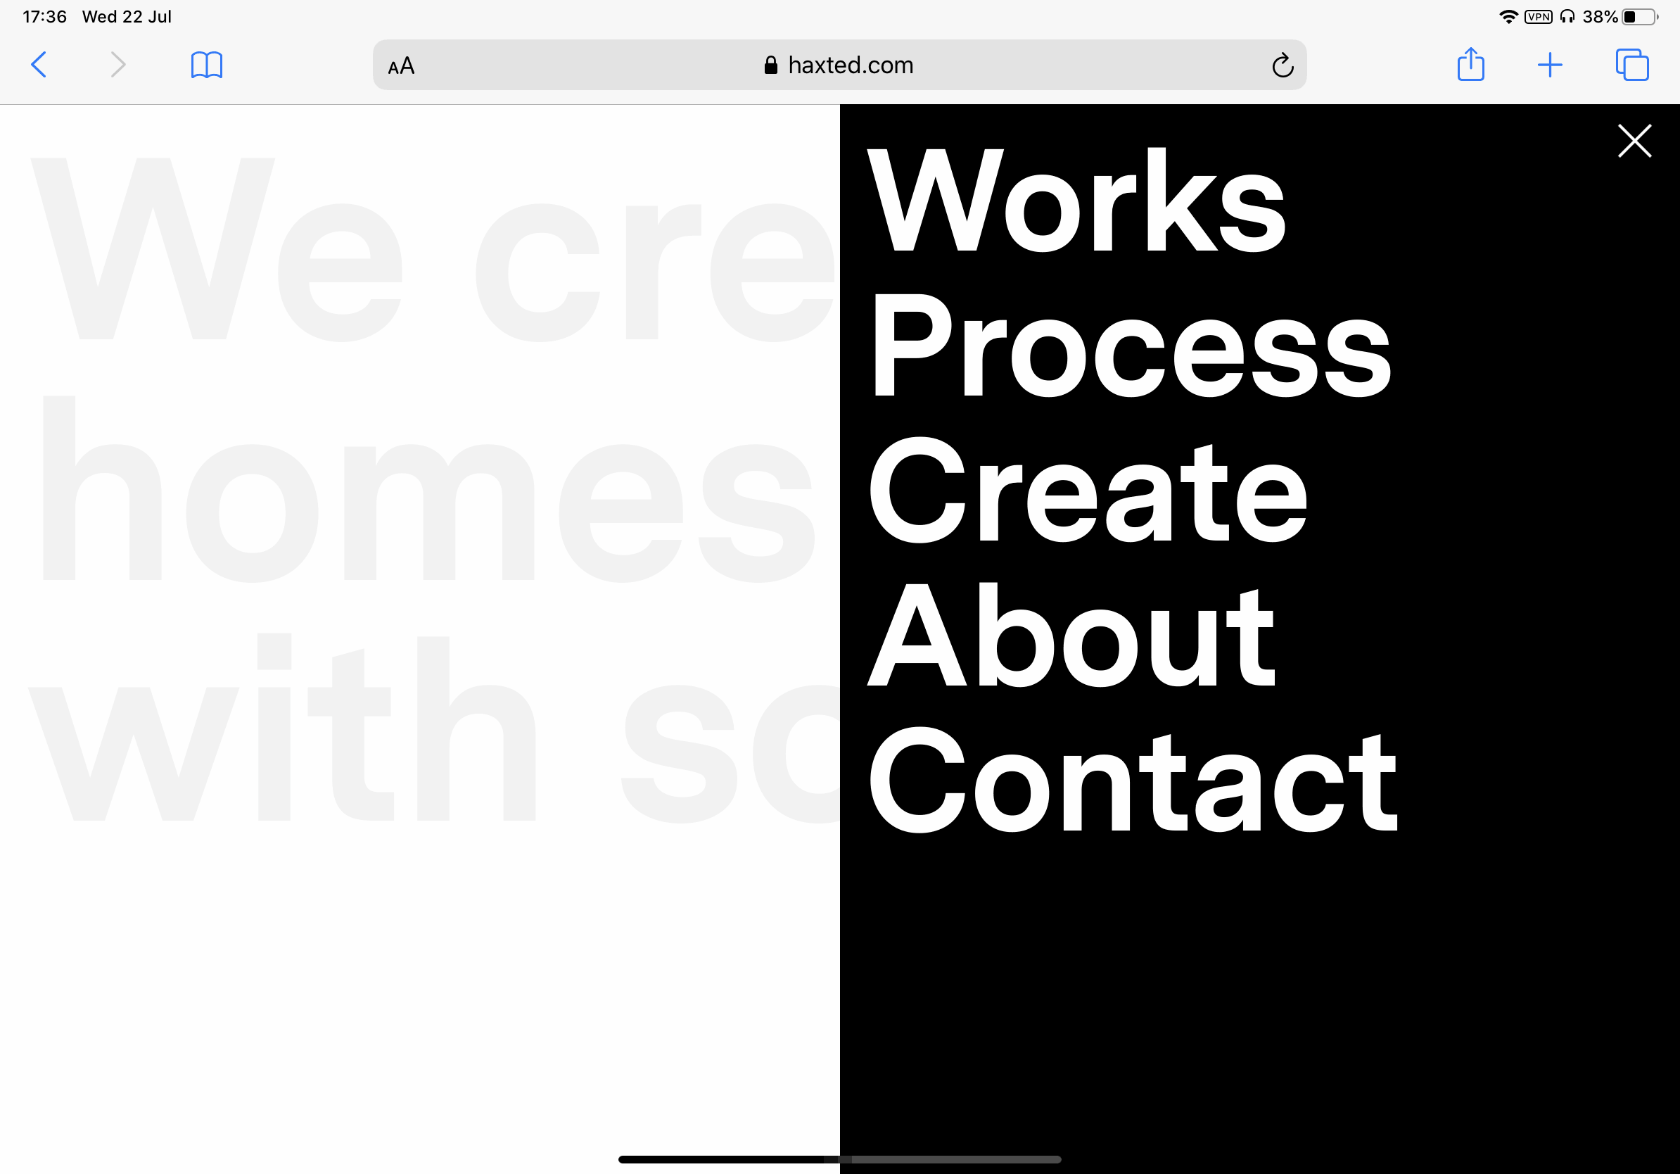
Example- overuse of hamburger menu
Too many links?
No just 5
Is this just a funny example of minimalism gone too far?

Slide 22
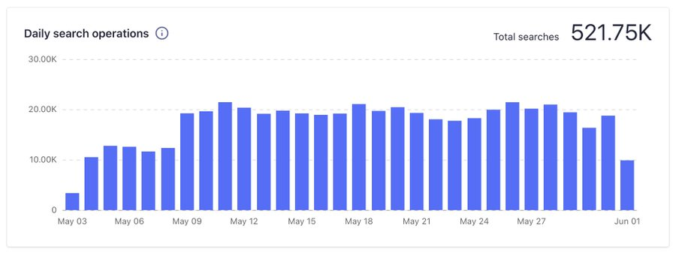
The problem with hidden features
Example- a website (Smashing Magazine) moved the search button from a hidden position under ‘menu’, to displaying it at all times
Result: 80% increase in searches

Slide 23
Icons without labels
Study
For icons with labels users were able to correctly predict what would happen when they clicked them 88% of the time
Icons without labels, this number dropped to 60%
For icons that are unlabeled and unique to the app (not used in other apps) this dropped to 34%

Slide 24
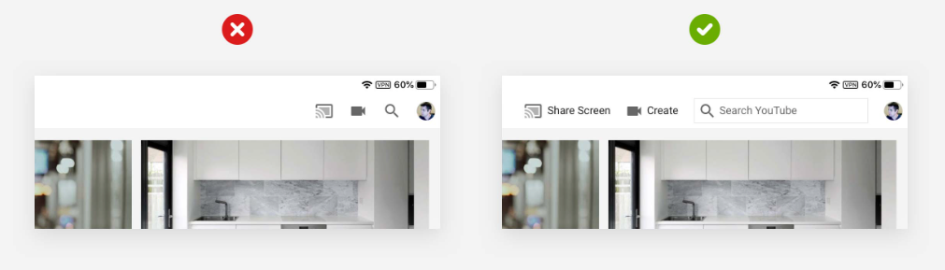
Which do we prefer- labels or none?
Youtube Ipad app
There is room for labels!

Slide 25
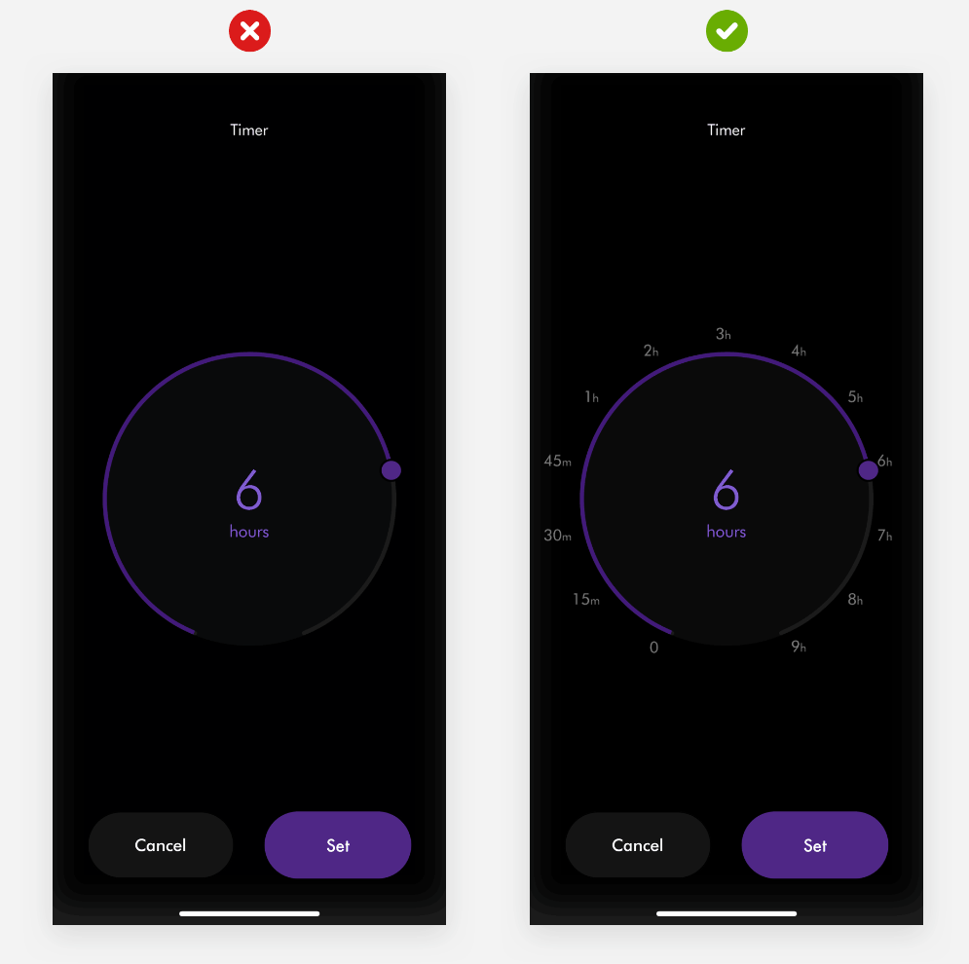
Which do we prefer- timer app

Slide 26
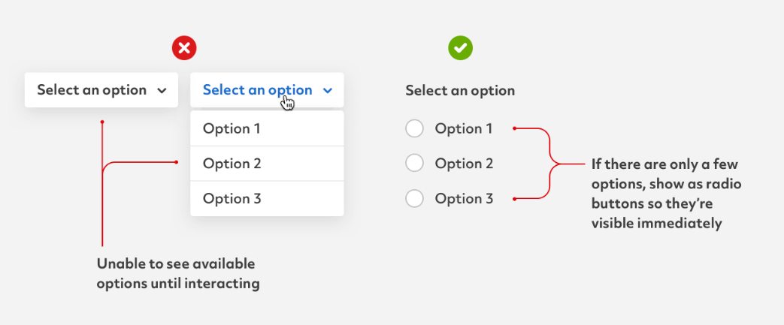
Drop downs vs visible menu

Slide 27
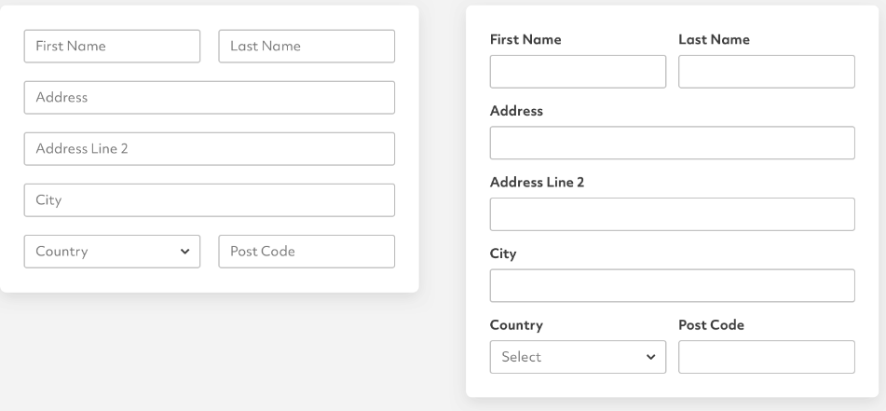
Which do we prefer?
Trade-offs
What can go wrong with the option on the left?
But the option on the right takes up more space….

Slide 28
Another- too much simplicity example

Slide 29
So how can we handle all the features we have
Simplicity is in tension with having a robust application with lots of features
How can this be addressed?

Slide 30
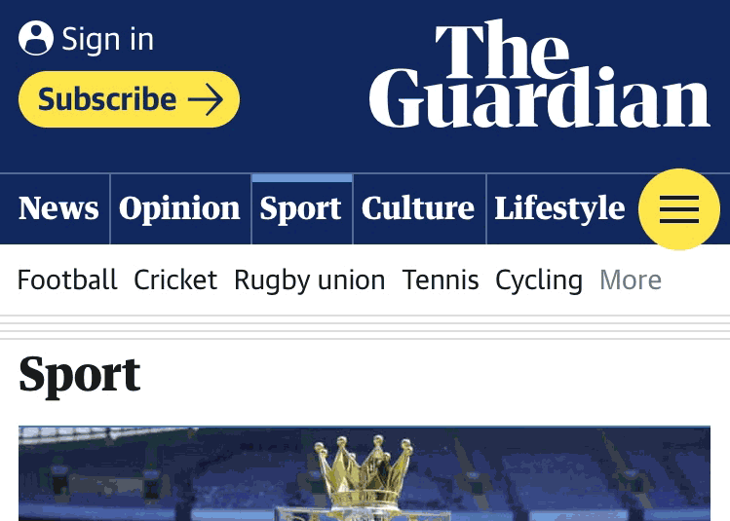
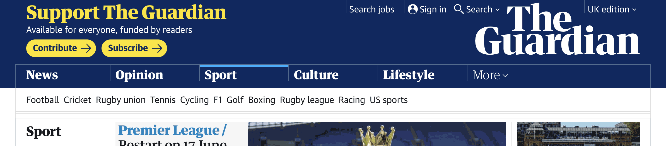
Let’s look at news websites
News websites have LOTS of information
How do they manage?
One approach: menus
Prioritized set of news content at the top
Hamburger menu for everything else
Or ‘more’ menu

Slide 31
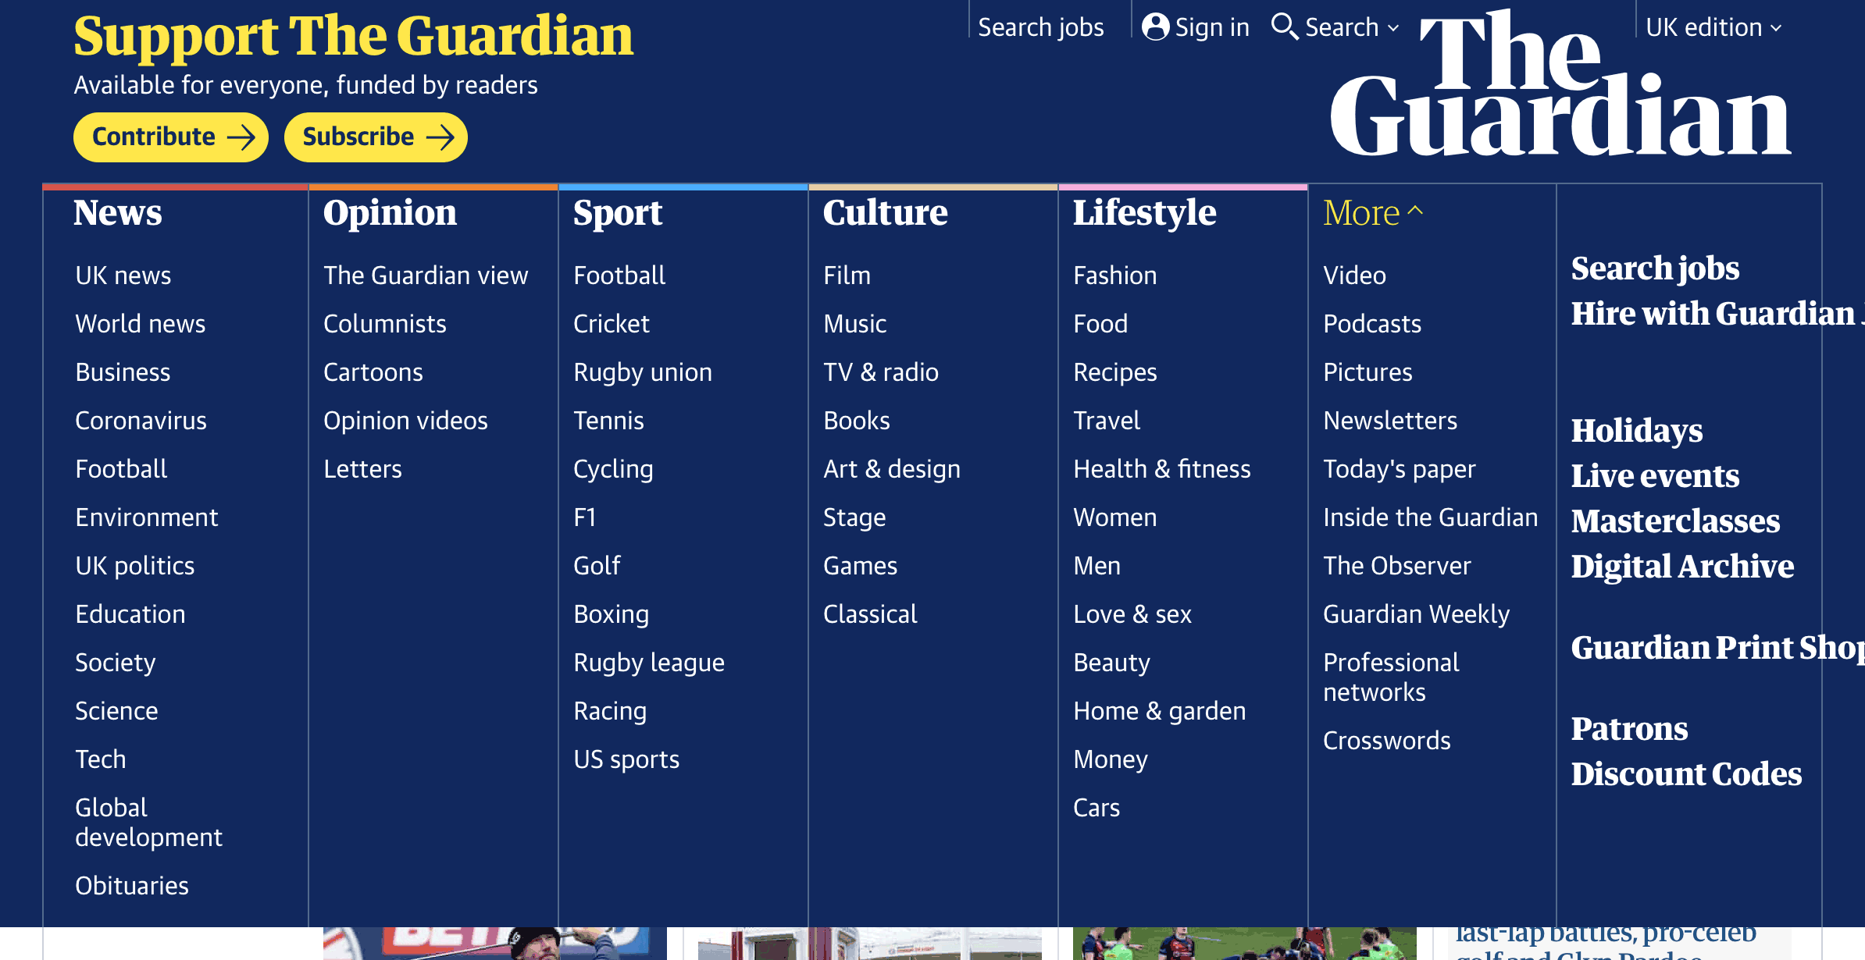
Menu

Slide 32
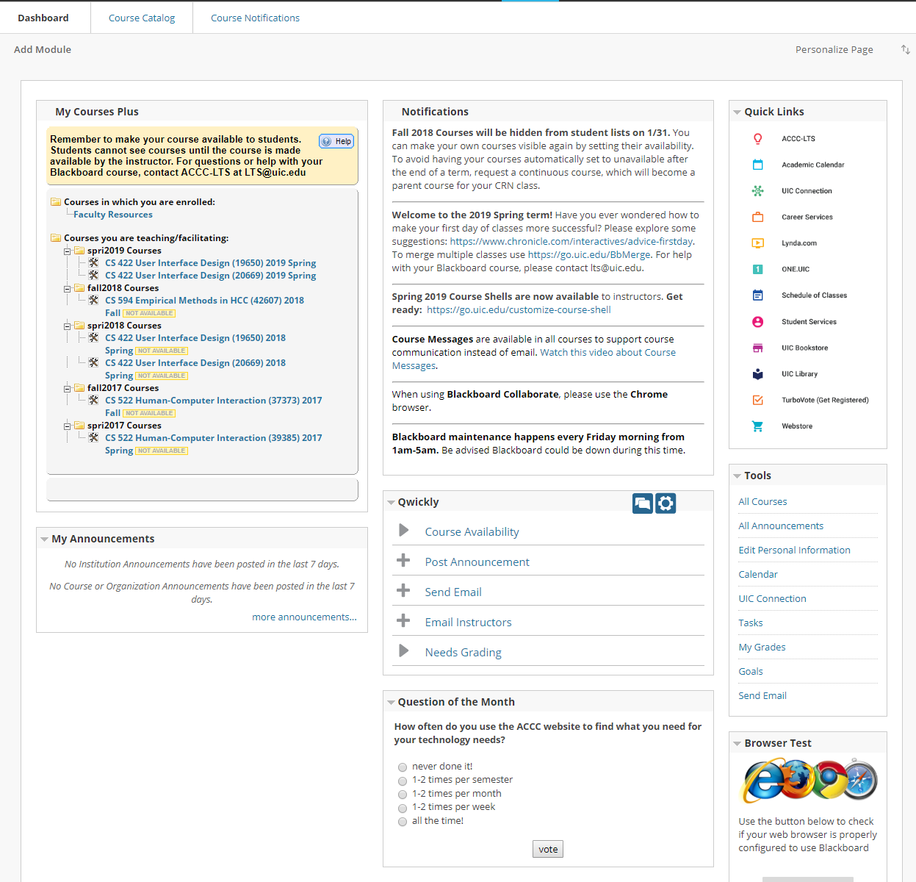
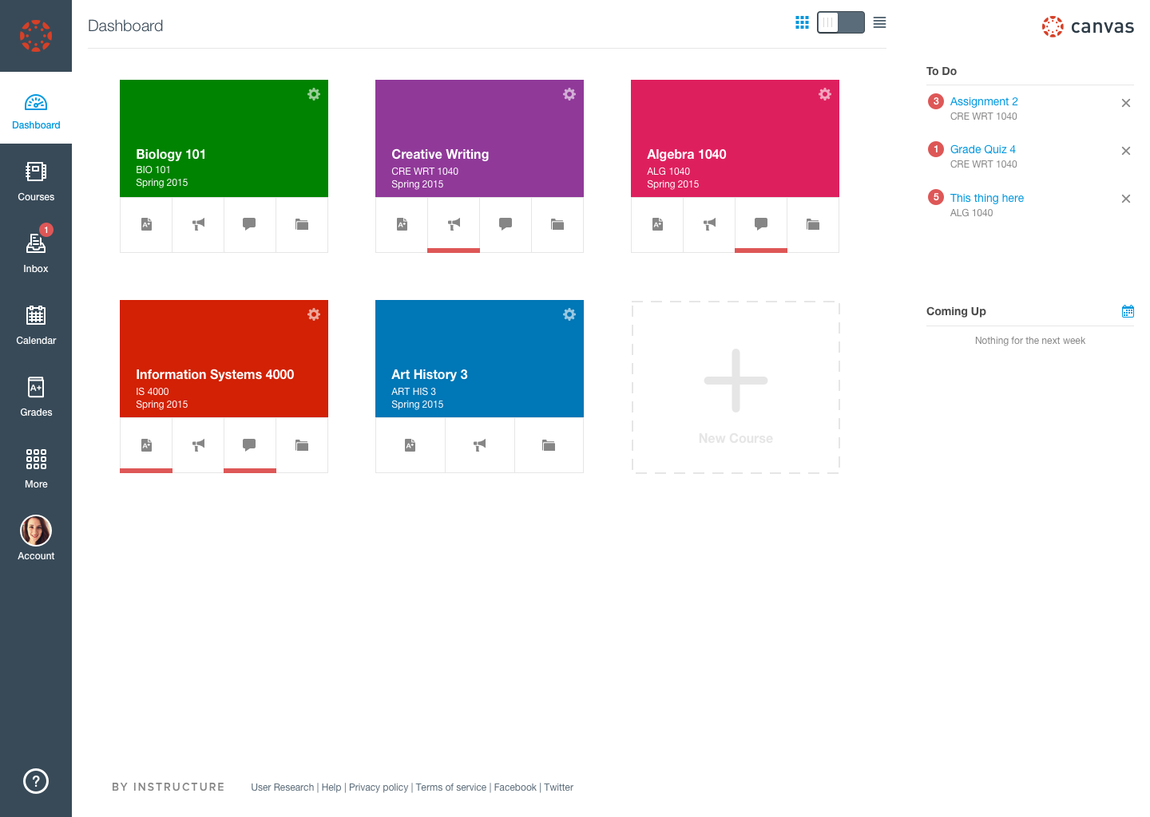

Slide 33
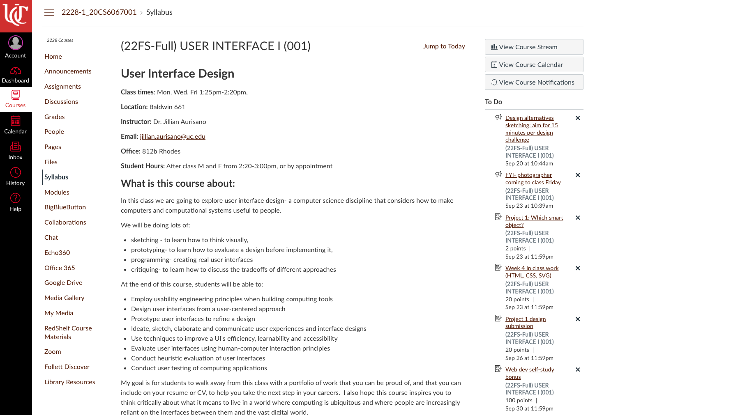
Let’s try to make a complex page, more simple
Canvas
Canvas has lots of features
I have used very few of them
What about you?
Can you make it simpler?
Reduce
What is the core function of Canvas for you and your group?

Slide 34
Graphic Design
Simplicity
Layout
Hierarchy
Balance and Symmetry
Alignment and Grids

Slide 35
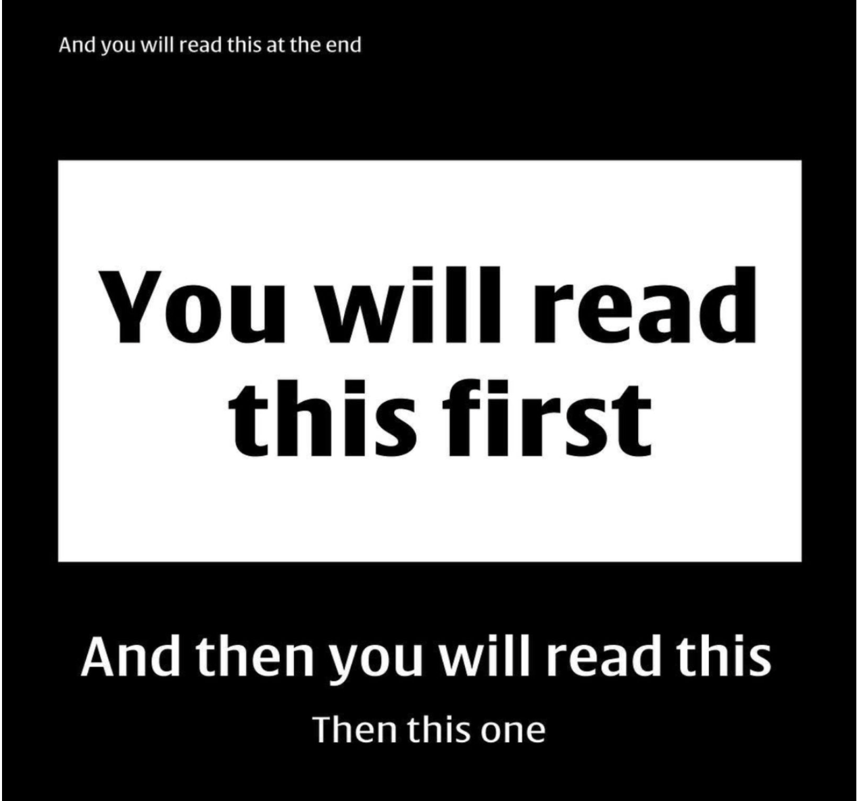
How we ‘read’

Slide 36
Visual hierarchy
How our brains help us see and comprehend the world around us, by scanning,
This impacts our behavior when interacting with digital interfaces.
If you understand the levels of attention each item on your page will get, it will help you design better pages / apps / software.
People will understand whatever it is that you’re wanting them to more quickly, with less effort.
Lack of visual hierarchy and poorly aligned content interrupts your brain's ability to scan and zone-in on areas of interest. If we cannot quickly understand what we see, we become frustrated and will likely leave the experience.

Slide 37
Visual hierarchy
Lack of visual hierarchy and poorly aligned content interrupts your brain's ability to scan and zone-in on areas of interest. If we cannot quickly understand what we see, we become frustrated and will likely leave the experience.

Slide 38
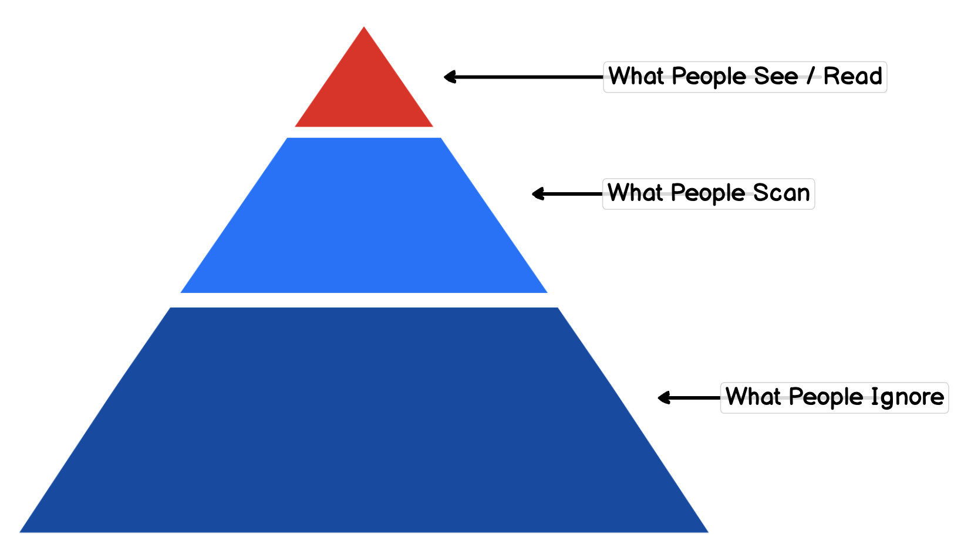
Visual Hierarchy

Slide 39
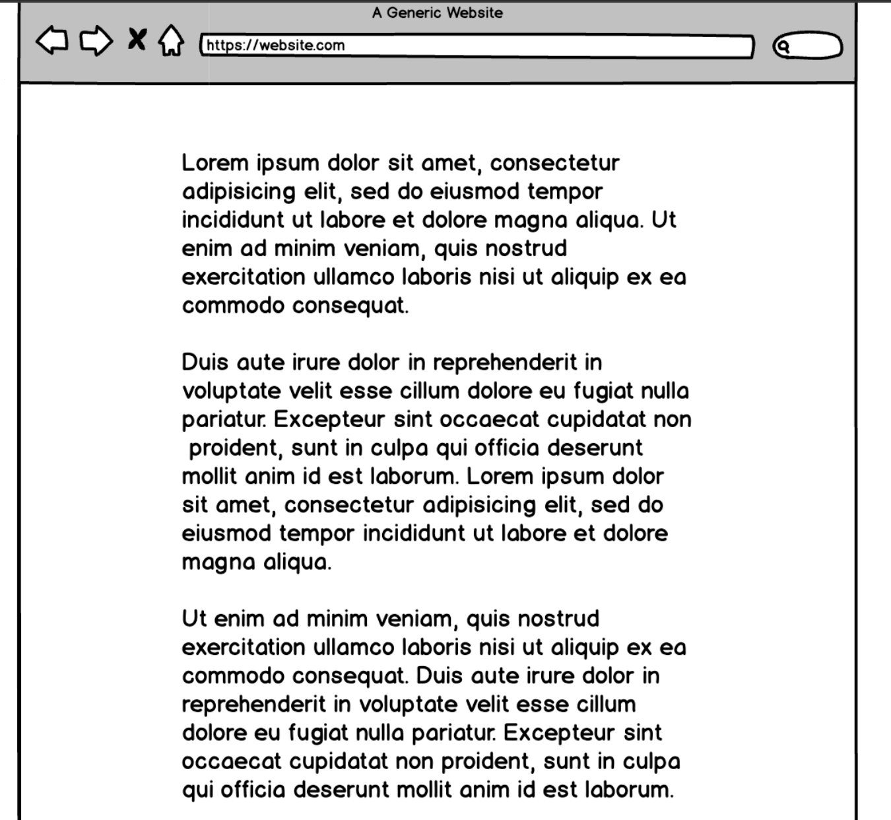
Example page with no hierarchy

Slide 40
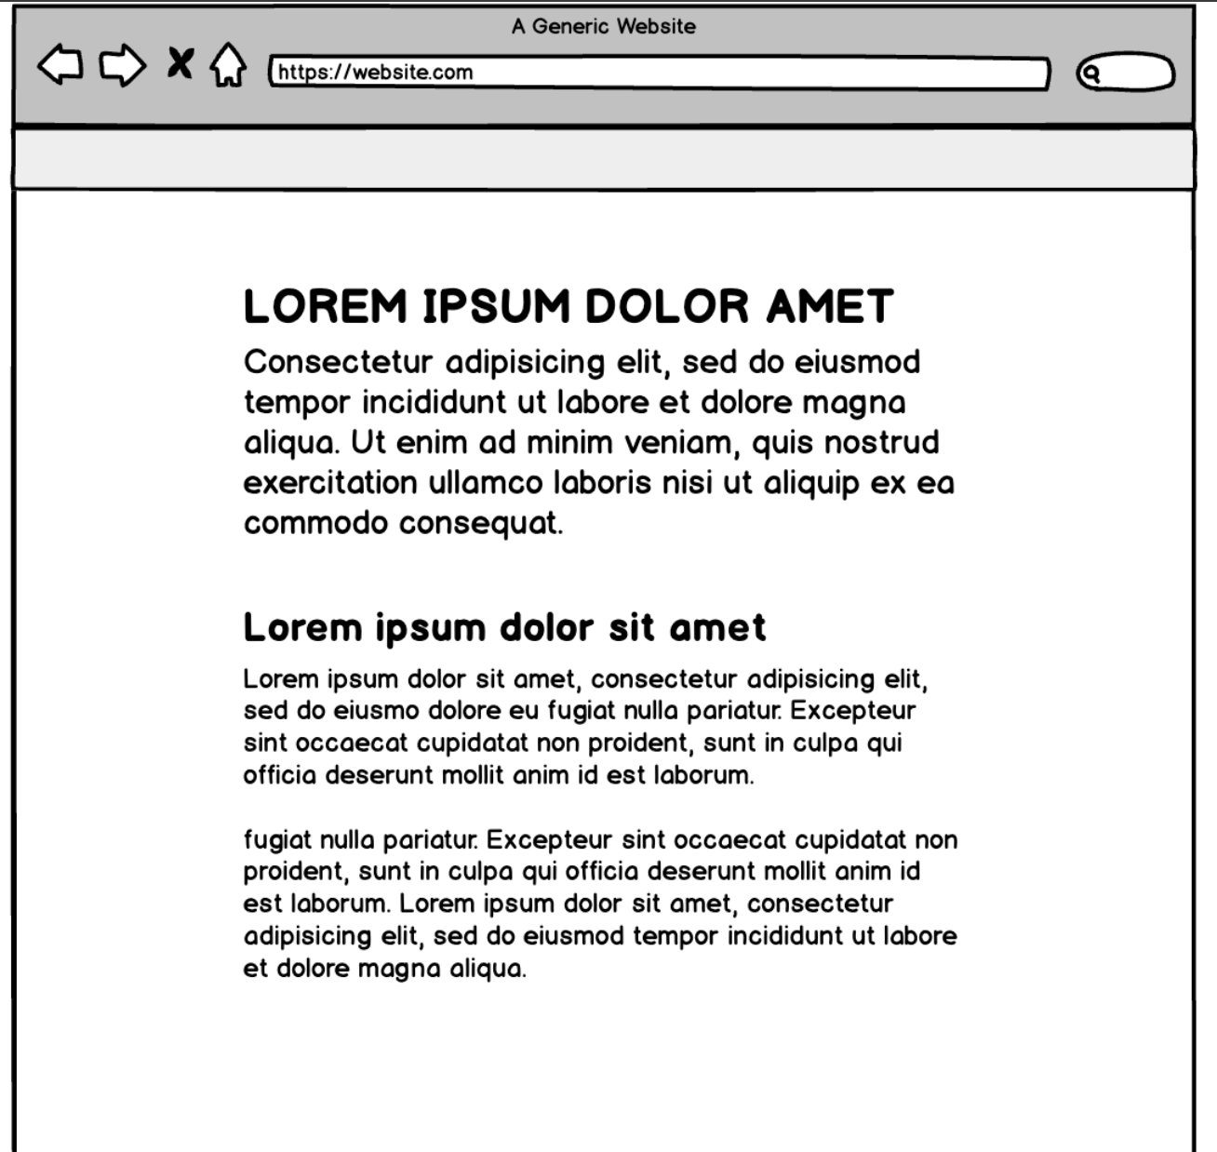
Better?

Slide 41
With no hierarchy….
With no hierarchy or places for your eyes to go
We cannot focus
Must use more of our attention to discern where we need to go next.
Sometimes this is used intentionally. When you place equal weight on the items on your page you are confusing your users.
It’s a common dark pattern sites use when they don't want you to take action at all (e.g., to cancel your membership). The example below uses a lot of similarity between the choices and the result is the user must study each section and read the button text to ensure they take the action they want.

Slide 42
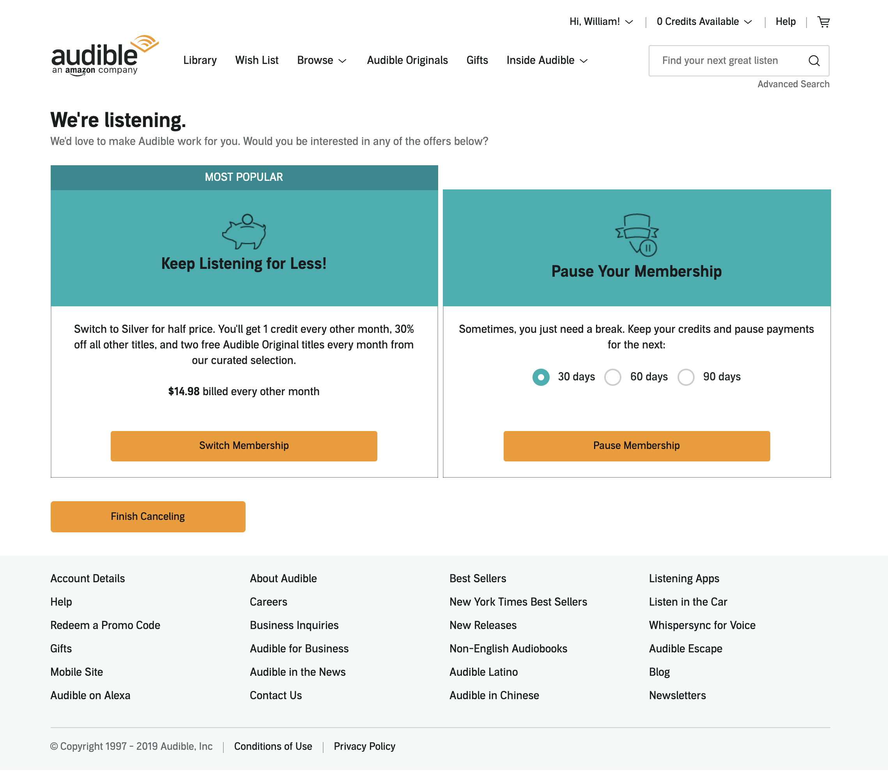
With no hierarchy….
Sometimes this is used intentionally. When you place equal weight on the items on your page you are confusing your users.
It’s a common dark pattern sites use when they don't want you to take action at all (e.g., to cancel your membership). The example below uses a lot of similarity between the choices and the result is the user must study each section and read the button text to ensure they take the action they want.

Slide 44
Alignment
Alignment helps people scan

Slide 45
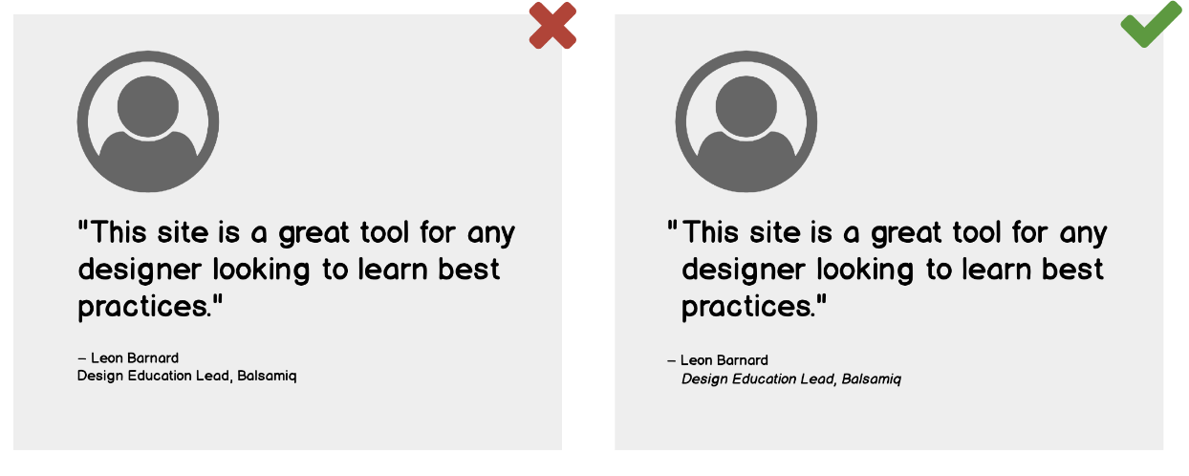
Can we spot the difference?

Slide 46
Can we spot the difference?
Text is aligned with text
Not with the quotation mark
Makes it easier to scan

Slide 47
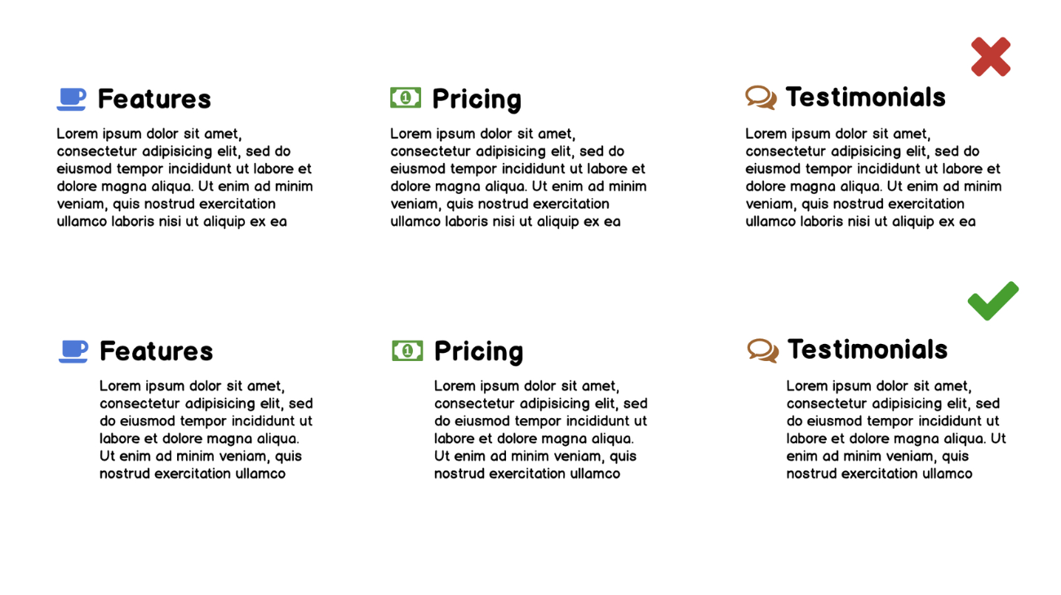
Another example
The bottom version will allow users to scan the text more smoothly

Slide 48
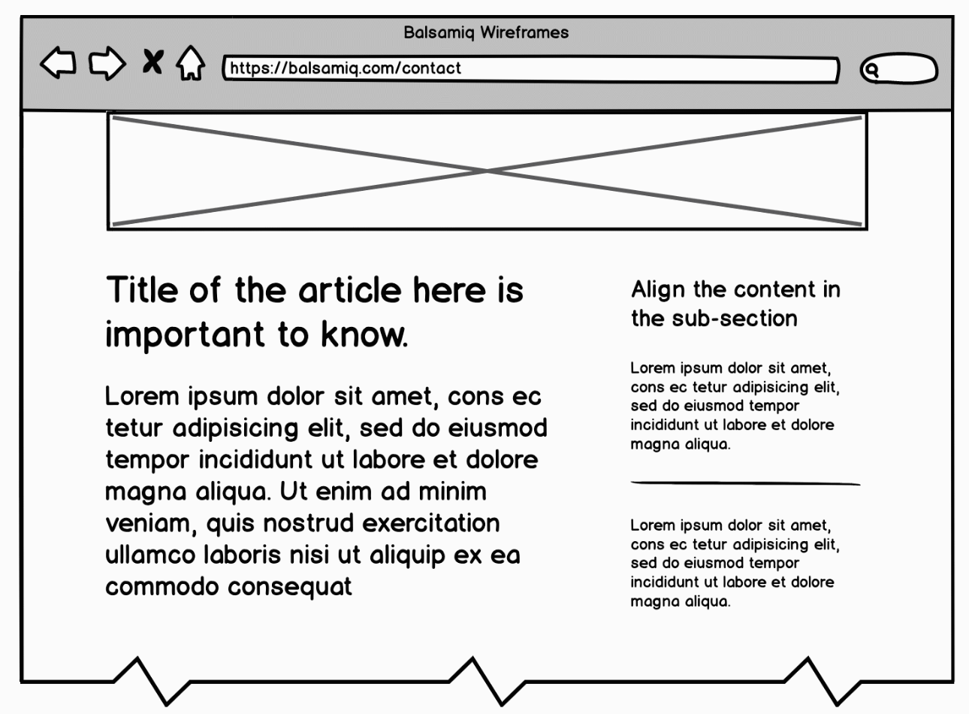
Horizontal Alignment
Let’s look at this example

Slide 49
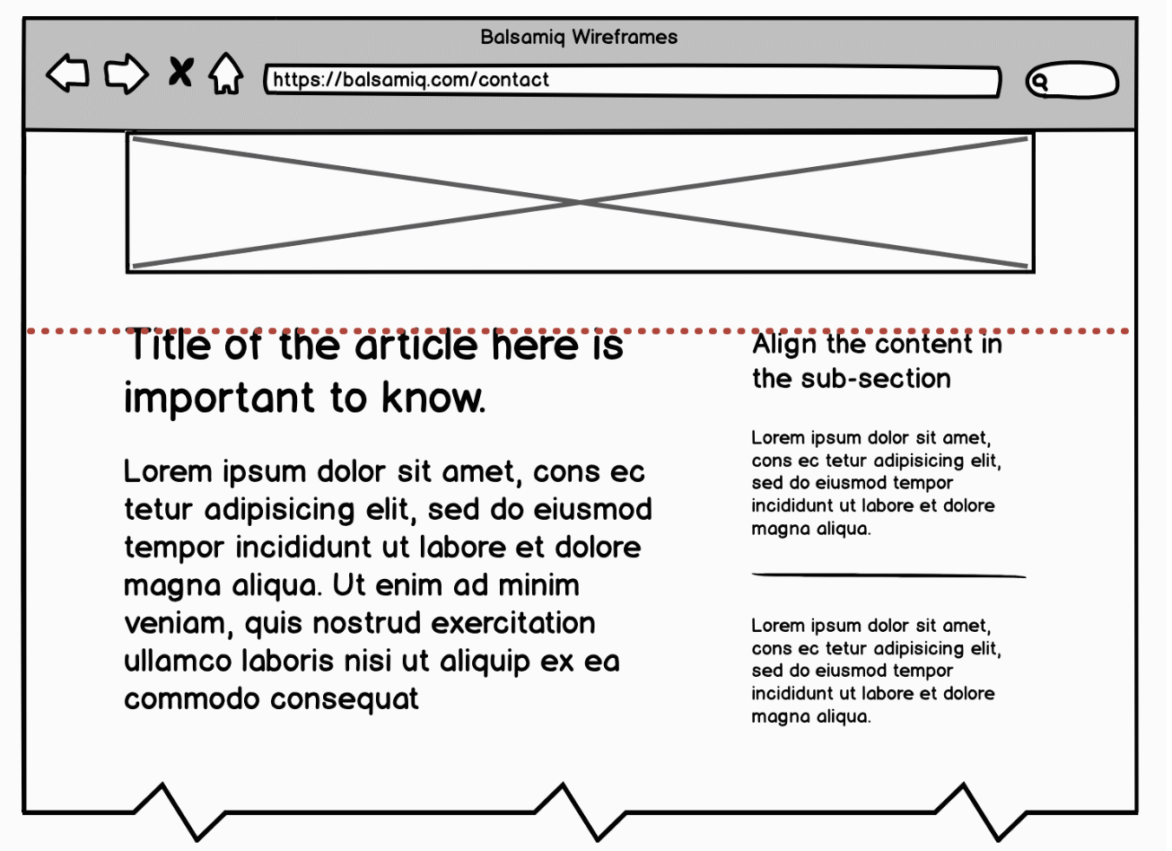
Horizontal Alignment
Let’s look at this example
The horizontal alignment of the text makes it easier to scan

Slide 50
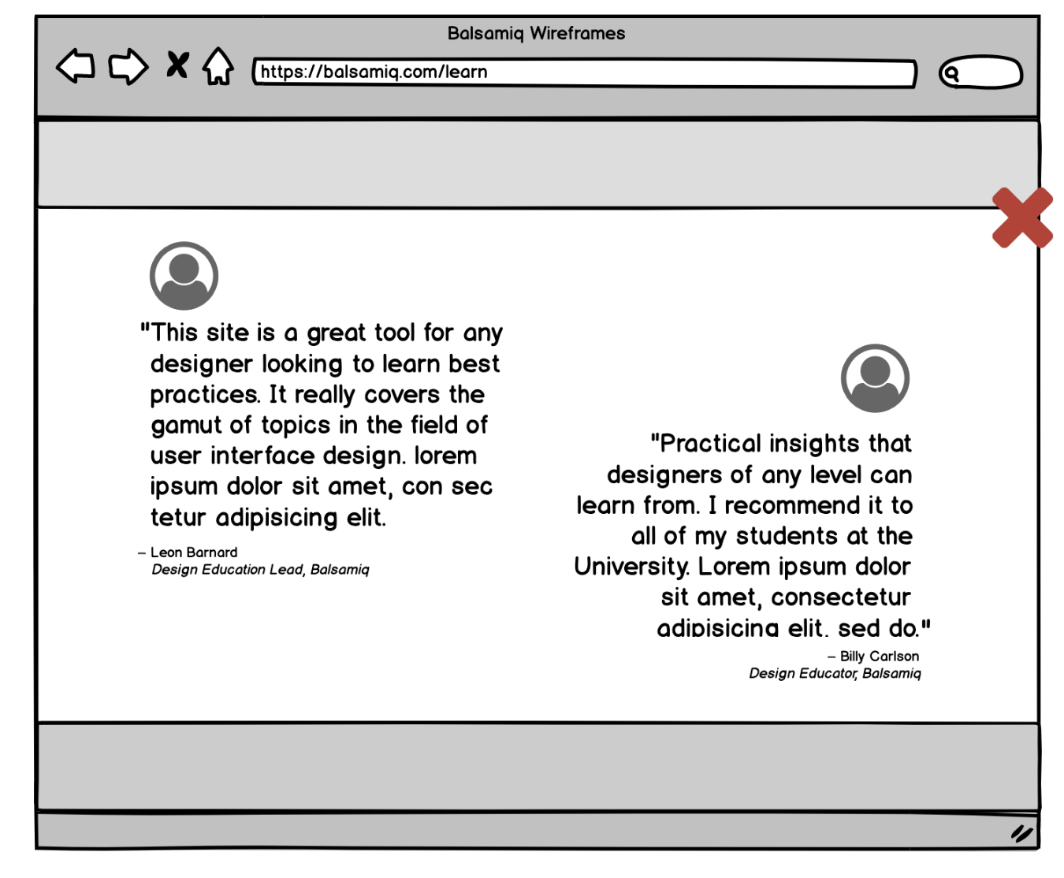
Horizontal Alignment and Eyeline
Look at this example
2 pieces of content
In the same ‘eyeline’
Our brains want to jump horizontally to the next piece of content.
This makes it hard to focus on the first bit of content.
Overlapping can cause disruptions to comprehending the content.

Slide 51
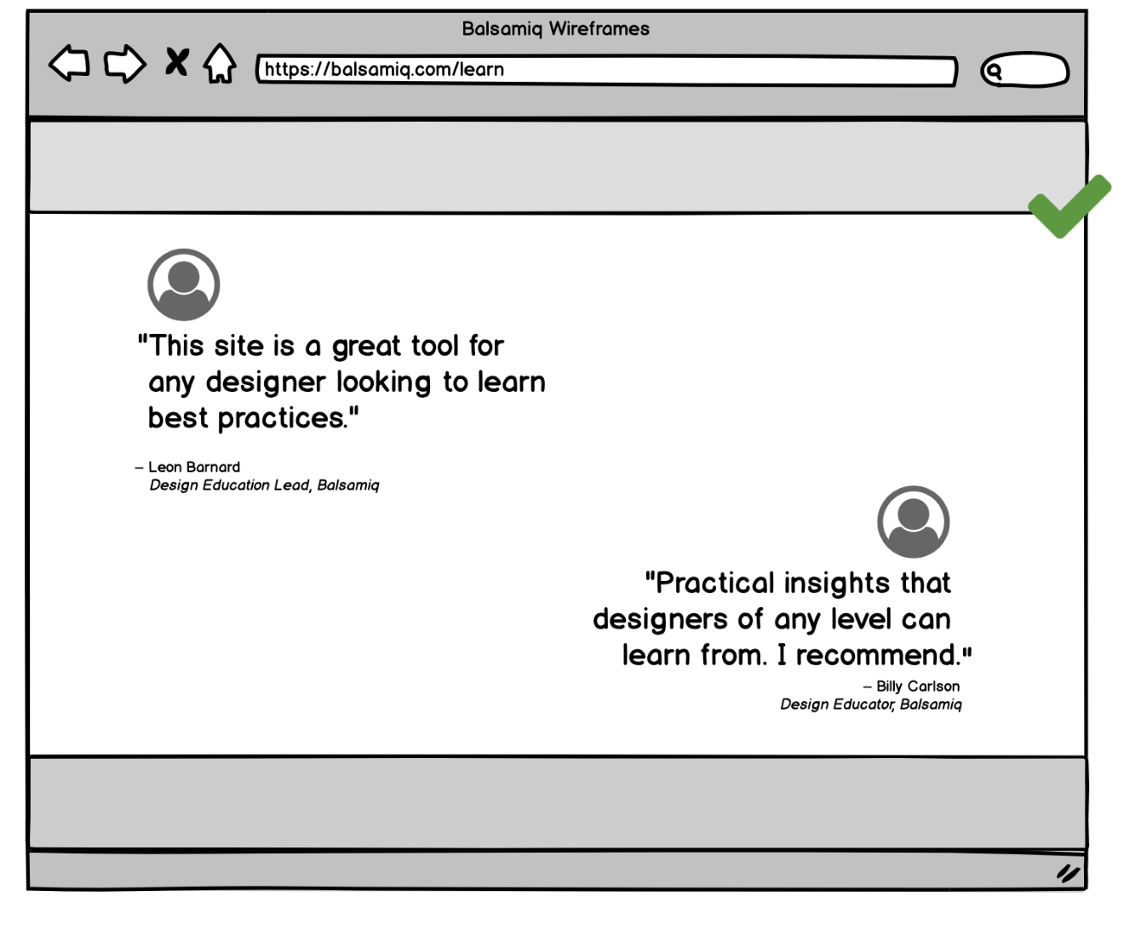
Horizontal alignment: Eyeline
Give some vertical space between things so the user can easily look at each area separately.

Slide 52
Graphic Design and Layout
Simplicity
Grouping and Hierarchy
Balance and Symmetry
Alignment and Grids

Slide 53
Balance and symmetry

Slide 54
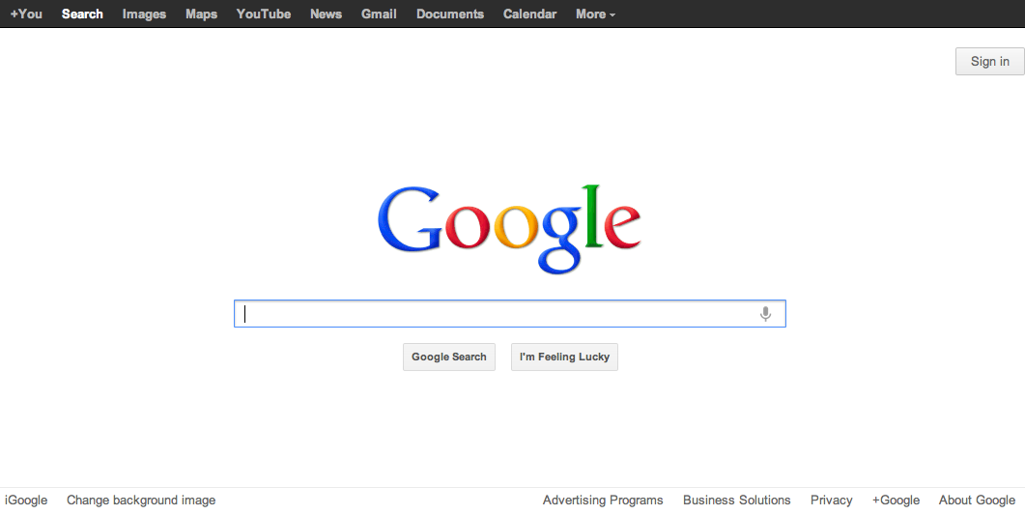
How to use balance and symmetry in UI design
Choose an axis (usually vertical)
Distribute elements equally around the axis
Equalize both mass and extent

Slide 55
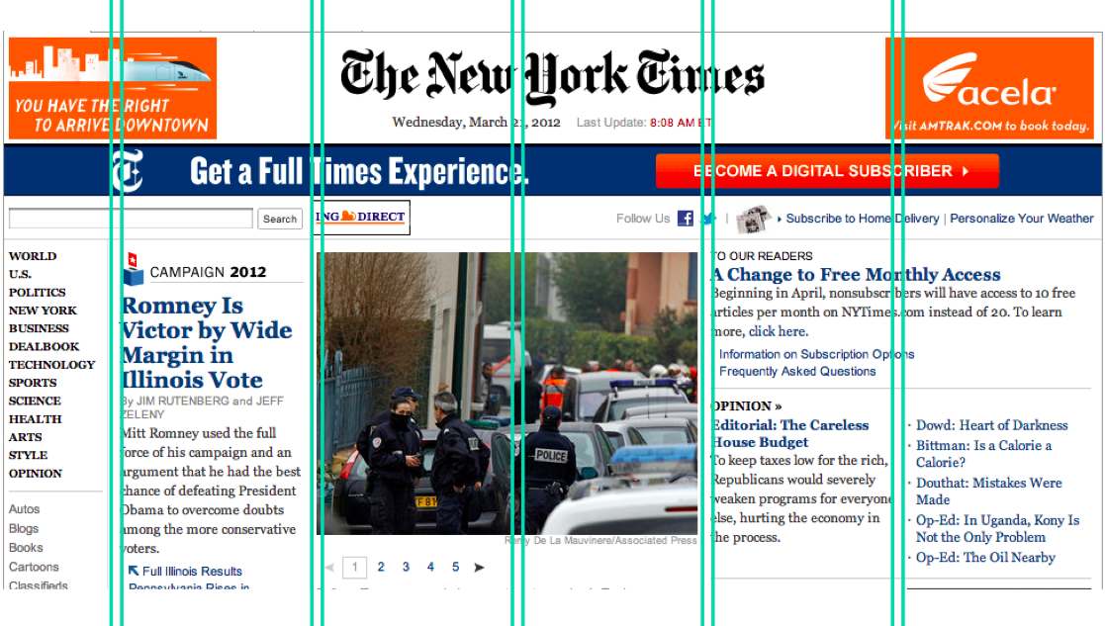
Grid-based design
A grid is one effective way to achieve both alignment and balance, nearly automatically.
A grid means that you divide the user interface into equal-width columns
separated by gaps, and with margins on both sides of the window
align content and controls on the column boundaries.
Some elements may span multiple columns, but they align (start or end at) column boundaries

Slide 56
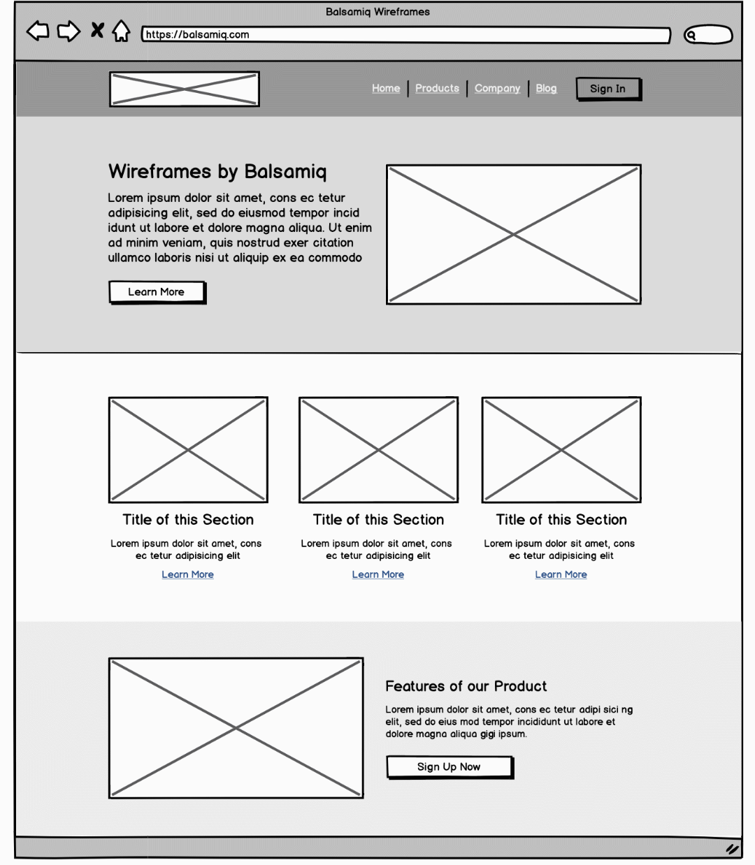
Grid-based design
Let’s find the alignment

Slide 57
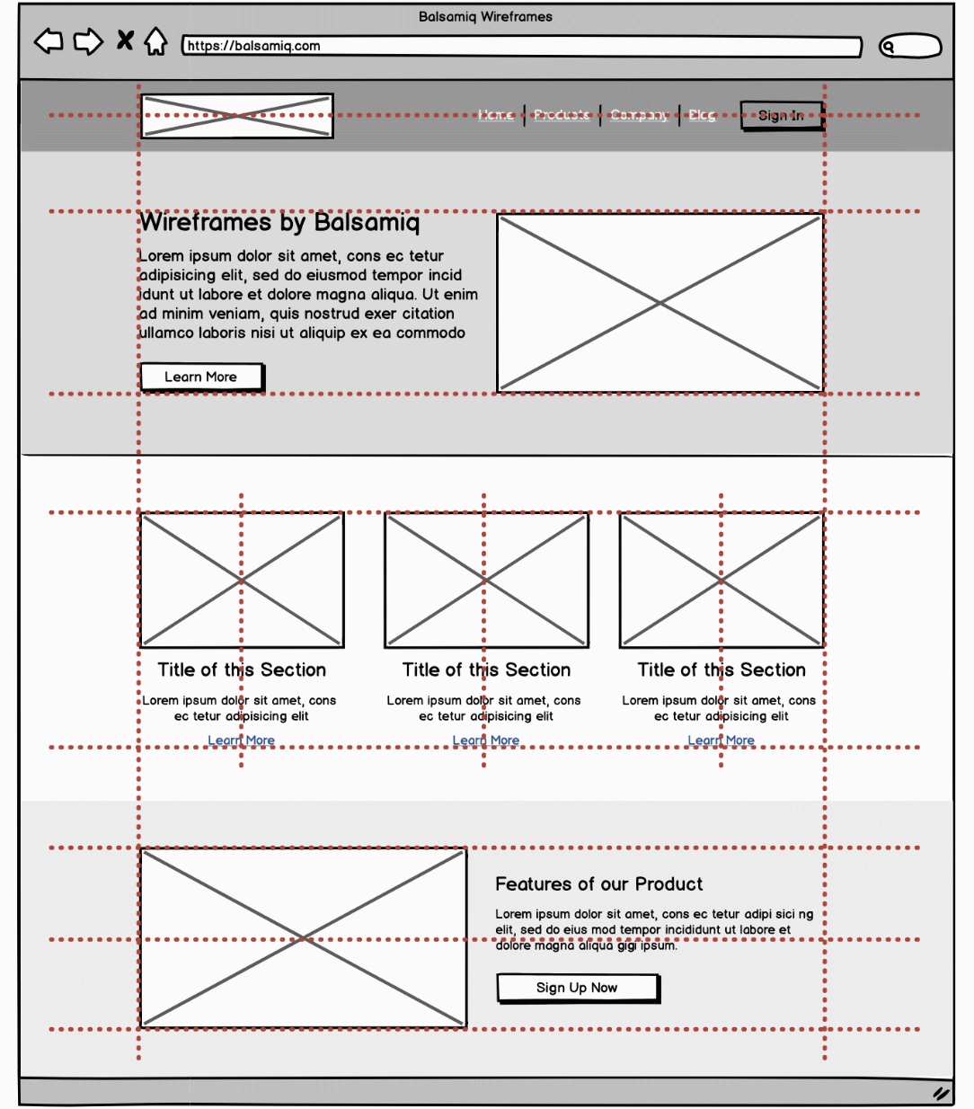
Grid-based design
So many places of alignment

Slide 58
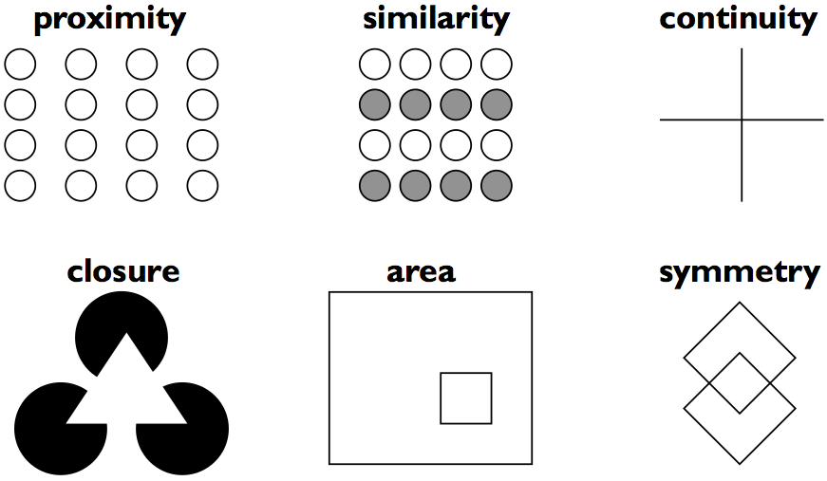
Psychological principle: Gestalt principles
1923 work: Gestalt laws of perceptual organization
We don’t ‘just see things’
Our brains do work to construct what we ‘see’
Gestalt principles are valuable to design

Slide 59
Gestalt principle
The human brain will attempt to simplify and organize complex images or designs that consist of many elements,
By subconsciously arranging the parts into an organized system that creates a whole, rather than just a series of disparate elements.
Our brains are built to see structure and patterns in order for us to better understand the environment that we’re living in.

Slide 60
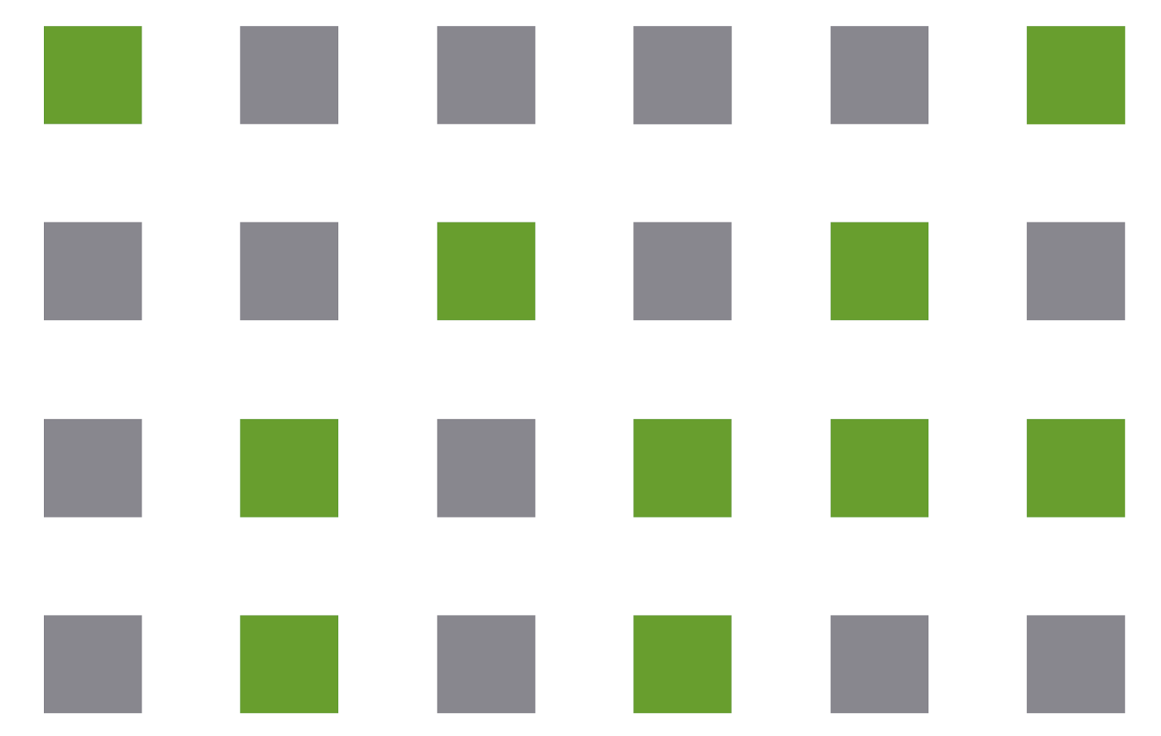
Similarity
Our brains group like things together.
In gestalt, similar elements are visually grouped, regardless of their proximity to each other.
They can be grouped by color, shape, or size.
Similarity can be used to tie together elements that might not be right next to each other in a design.

Slide 61
Similarity and UI design
Makes it clear which items are alike.
For example: features list using repetitive design elements- an icon accompanied by 3-4 lines of text
The similarity principle would make it easy to scan through them.
In contrast, changing the design elements for features you want to highlight makes them stand out and gives them more importance in the visitor’s perception.

Slide 62
Similarity- make some things stand out
You can make things dissimilar if you want to make them stand out from the crowd.
Buttons for calls to action are often designed in a different color than the rest of a page—so they stand out and draw the visitor’s attention to the desired action.

Slide 63
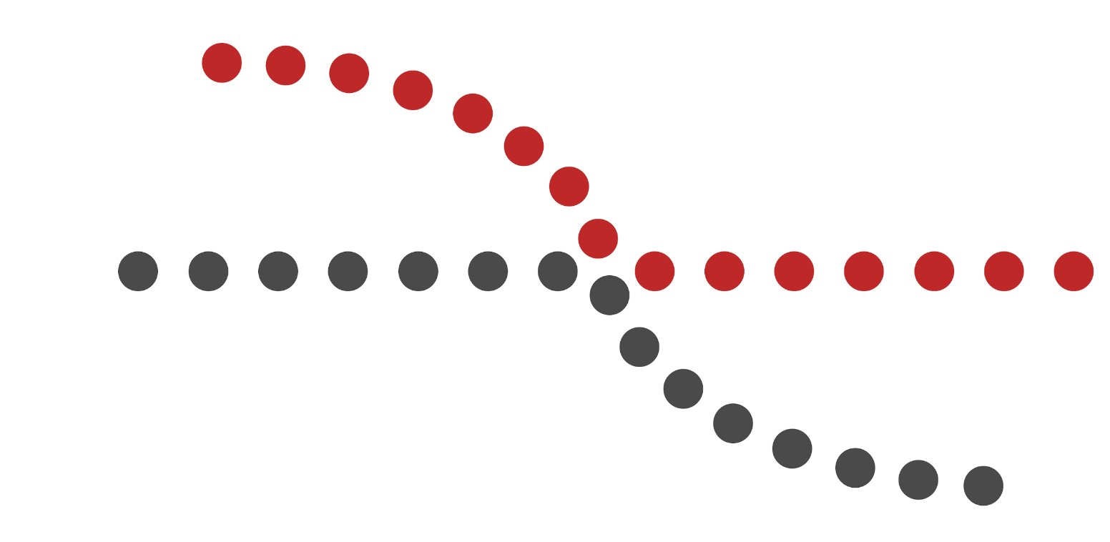
Continuity
Our eyes will follow the smoothest path when viewing lines,
Even if not given an actual line
Use this to guide your user’s eyes
They will follow the simplest path on the page, so make sure the most vital parts they should see fall within that path.

Slide 64

Closure
Our brains complete the image
Example: Show a partial image fading off the user’s screen in order to show them that there is more to be found if they swipe left or right.
Without a partial image, i.e., if only full images are shown, the brain doesn’t immediately interpret that there might be more to be seen, and therefore your user is less likely to scroll (since closure is already apparent).

Slide 65
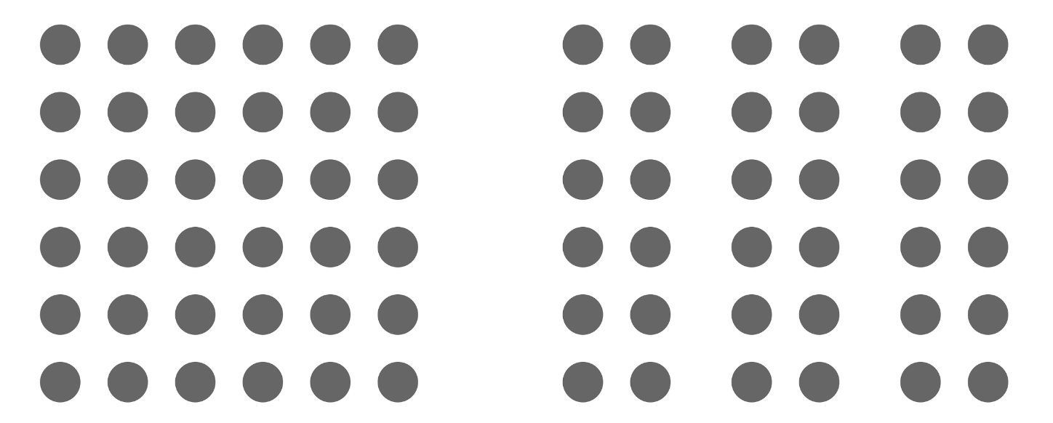
Proximity
Proximity is most often used in order to get users to group certain things together without the use of things like hard borders.
By putting like things closer together, with space in between each group, the viewer will immediately pick up on the organization and structure you want them to perceive.

Slide 66
Slide credits
Debaleena Chattopdhay
https://www.toptal.com/designers/ui/gestalt-principles-of-design#:~:text=There%20are%20six%20individual%20principles,gestalt%2C%20such%20as%20common%20fate.
https://balsamiq.com/learn/articles/visual-hierarchy-and-alignment/
https://www.interaction-design.org/literature/article/simplicity-in-design-4-ways-to-achieve-simplicity-in-your-designs
https://tomkenny.design/articles/false-simplicity

Slide 67
Graphic Design and Layout
Simplicity
Contrast
Grouping and Hierarchy
Balance and Symmetry
Alignment and Grids

Slide 68
Visual Variables
We are designing content perceived by human visual system
Let’s consider visual variables – the variables we have available to modify how content is presented visually

